Slide 1
Dell Rapids Lions Club “We Serve”
http://dellrapidslionsclub.org/

Slide 2
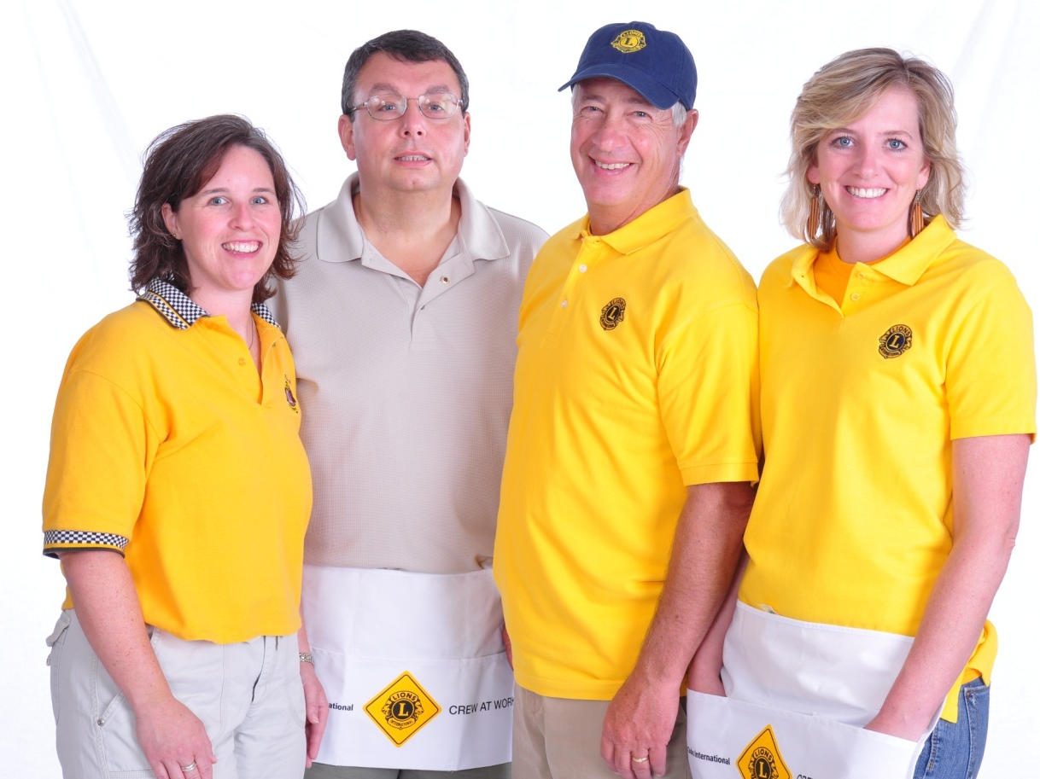
Who Lions Are
Lions are: men and women dedicated to serving those in need, whether in their own community or around the world.
Nearly 1.4 million members
Over 200 countries
More than 46,000 clubs
Vision Statement: To be the global leader
in community and humanitarian service.
Mission Statement: To empower volunteers to
serve their communities, meet humanitarian
needs, encourage peace and promote international understanding through Lions clubs.
Motto: “We Serve”
Code of Ethics: LCI (Lions Clubs International) has a code of ethics which set the standard that Lions should aspire to adhere to.
Purposes: LCI has a list of purposes to convey why Lions clubs exist.

Slide 3
Membership
The benefits of Lions clubs membership are numerous, and include:
Helping those in need
Making a difference in your community
Having an impact on those in need worldwide
Developing leadership skills
Enhancing communication skills
Utilizing planning and organization skills
Working hands-on to meet community needs
Meeting new people
Opportunities to network and travel

Slide 4
Club Officers
Officers (07/2023 to 06/2024)
President: Robert Wiarda
Immediate Past President: Tom Ludens
Vice President: Tom Early
Treasurer: Peg Nelson
Secretary: Sue Hovey
Program Directors: Darrold & Diane Williams
Membership Chair: Christine Snyder
Lion Tamer: Connie Early
The Lion Tamer keeps order and distributes materials at meetings and sells
chances for the Lion Tamer drawing.
Tail Twister: Tom Early
Serves to promote harmony, good fellowship and enthusiasm at club meetings
through the judicious imposition of “fines” on members. (Lions horn honker.)
Elections
Club president appoints a nomination committee in March
The nomination committee selects officer candidates in March
The club votes on nominations April & officers are swore in at May/June.
Officers are elected annually with their term starting July 1st.
Communication
Dell Rapids Lions Monthly Meeting Minutes are e-mailed to each member monthly
E-mails to members as needed to let members know about upcoming items
SD Lions District Newsletter is emailed to each member monthly
Lions International magazine is mailed to each member
Web Site – Lions Club information, list of members, chat, e-mail members, etc. - http://dellrapidslionsclub.org/
Notes:
Trainer Tip: Add the names of the current club officers. Add or remove bullet points if your club has different officers than those listed.

Slide 5
Club Information
History
Year chartered: September 1944
Clubs sponsored by us: Colton Lions Club
Members who served as District Governor: Gary Smith 1995-1996
Meetings
When: 1st Thursday of every month
Time: 6:30 pm to 8:00 pm
Where: Pizza Ranch in Dell Rapids in back room
Committees: will meet as needed and to be set up by each individual committee
Traditions – the club has donated to the following areas below in the past years
South Dakota Lions Foundation
South Dakota Lions Eye and Tissue Bank
Leader Dog School for the Blind
Christmas for our Kids
Dell Rapids Community Haven
Dell Rapids FCCLA (Family, Career, and Community Leaders of America)
Dell Rapids Museum - Festival of Trees
Dell Rapids Boy Scouts
Dell Rapids Boy Scouts
Dell Rapids Baseball Association
Dell Rapids Special Olympics
Dell Rapids Back Pack Program
Ski for Light – South Dakota Association of the Blind
Dell Rapids Society for Historical Preservation
Dell Rapids Food Pantry
Dell Rapids Carnegie Library

Slide 6
Fundraising Activities
All money raised is used to sponsor community activities, hardship cases, eye glasses, hearing aids etc.
To become involved in or to run a fundraiser, please contact the club president. They can discuss the possibility of turning the project over once the fiscal year is done or adding you to the committee.
Activities
Meat Raffle – Lions Club works with Norby’s bar to set up 1 Friday a month Oct to April to hold the raffle. Chairperson obtains meat from County Fair store at a discount. Tickets are printed up in advance for 10 rounds. Event is hosted at Norby’s Bar and Grill. Chairperson and volunteers sell raffle tickets and spin the wheel for winners of the meat and free drink tickets from Norby’s.
Aluminum Can Collection – Lions Club has a can trailer is located on the eastern lot at Orleans and 3rd street where anyone can deposit their aluminum cans. Once the trailer is full, it is taken to Sioux Falls and unloaded at the recycle place. They weigh the cans and give the Lions Club a check.
Pancake Breakfast – Lions Club members get together each spring and host a Pancake Breakfast at the Catholic church kitchen. We make fluffy light pancakes, lip smacking sausage, juice, and coffee. Members mix pancake batter, make homemade sausage, cook, server customers, clean up tables, pour coffee, wash dishes, etc.
Quarry Days Trash Collection – This is where the Chamber of Commerce pays the Lions Club to pick up trash during the Quarry Days activities weekend. It is a fun way to say hello to our friends and family enjoying the event.

Slide 7
Projects – summarized
To become involved in or to run a project, please contact the club president. They can discuss the possibility of turning the project over once the fiscal year is done or adding you to the committee.
Eye Glass Collection – Used eye glasses are collected at County Fair store and First National Bank downtown, in Dell Rapids. The chairperson collects the eye glasses that have been donated and drops them off at the Lions Foundation in Sioux Falls. They give the eye glasses to VOSH (Volunteer Ophthalmic Services to Humanity). VOSH distributes the eye glasses to a person in need in third-world countries.
Scholarship Award – Dell Rapids Lions Club awards a graduate of Dell Rapids High School or St Mary’s High School a $1,000 scholarship to be used for post-secondary education. The award is based on the student’s essay and community service.
Kids Vision Screen– This is where the Dell Rapids Lions Club screens children’s eye sight. This is in hopes of catching any potential eye sight issues early in children. If the screening shows concerns, the parents of the child are alerted to this and encouraged to seek professional care from an Optometrist. (We do annual screenings at Quarry Days and during the school year. We also volunteer to help screen when asked from other organizations.)
Dell Rapids Homecoming Dance (St Mary’s and Public) – Lions Club assists with monitoring the popcorn and pop as needed. Also, to be available if a student has an issue so you can direct them to a teacher or parent.
Boy Scout Derby – The Dell Rapids Boy Scouts conducts a toy car derby that the Lions Club assist with. We sit at a table and take names of the participants along with the weight of their car. We also help place the cars on the track and pick them up from the finish line and give it back to the participant. It is a very fun event.
Notes:
Trainer Tip: Consider adding photos from the projects to the slide if they are available.

Slide 8
Member Expenses
Dell Rapids Lions Club dues: $84.50 (District 5-SE = $10; Multiple District 5 = $6; SD Lions Publication = $5; SD Hall of Fame = $0.50; International = $43 and Dell Rapids Lions Club = $20) – each member pays this to the treasurer once a year. Spouse of a member will have dues of $63. (Dues can also be paid in two installments – see treasurer for details. This is 2023 information.)
Spouse of a Lions member dues are discounted at $63.00
Vest or T-Shirts: available for purchase from the Club Secretary
Lions Club Pins– Cost may vary dependent on who sells them – (usually $3 - $6 each). You can also purchase clothing, hats and other items with the Lions Club logo.
Link to site: https://www2.lionsclubs.org/t-productnotfound.aspx
Budget
Activities Budget – all fundraising
monies go into this account and used to give
back to the community
Business Budget – dues, Tail
Twister monies and internal club raffle
go into this account for club
expenses.
Notes:
Trainer Tip: Explain that the activities budget consists of funds raised form the public through club projects and may only be expended to satisfy a community or public need. The administrative budget is what finances club operations and comes mostly from club dues.

